Slide 1
Lec: 39 - SFSS - SP – 07d
Solution regarding Child Labor

Slide 2
Remedies

Slide 3
Child labor is a complex phenomenon. Its root cause is poverty-included illiteracy of their parents and social attitudes.
To combat child labor effectively, an action-oriented approach has to be adopted, which takes into account social, economic and cultural factors.
Child labor cannot be approached as an isolated phenomenon, its reduction and elimination will require a set of direct and in direct, short term and long term measurements though, inter-related measures.
Few measures include,

Slide 4
Employment Chances for Parents
Improve Income of the Family / Income generating schemes
Good home environment
Implementation of the law
Co-Ordination between GOs and NGOs

Slide 5
Encourage Education of the Children
Establish more Schools
Make the Schools Attractive
Teachers training regarding Child’s Psychology
Public Awareness

Slide 6
Experience has shown that withdrawing children from the worst forms is possible, but cannot be successful without a strong Political Will.
This ‘will’ must in National Policy that addresses issues such as improved legislation and enforcement; improved methodologies for identifying these children; awareness raising at all levels of society and the provision of possible alternatives for the children and their families, including rehabilitation measures.

Slide 7
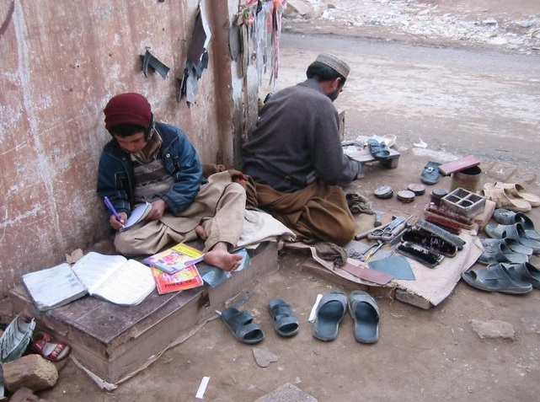
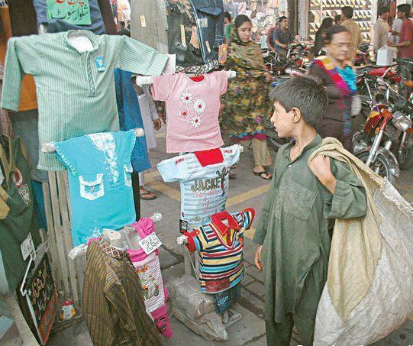
Child Labour :
They have Dreams like ours…

Slide 8
Thanks

